Slide 1

BANK OF SUCCESS
WELCOME
Bank
Supervisor: Lakshmi Iyer

Slide 2
Team Members:
Haritha
Kavya BN
Kumari Nisha
K Naveen
Praveena K
Raghavendra E
Ramya R
Ranganath S
Vishal Kumar

Slide 3
Topics included
Problem Statement
UML Diagram
Concepts Used
Validations
Signup for user
Login
Deposit an Amount
View Balance
Withdraw an Amount
Set Pin
Close an Account
Swaggers
Code snippets

Slide 4
Database used to store data
MySQL.

Slide 5
Problem Statement:
To develop a software for solving financial application of a customer in banking environment.
REST API endpoints regarding:
Open
Change Pin
Deposit
Withdrawal
View Balance
Close
Bank is going to offer two Accounts
Savings Account
Current Account

Slide 6
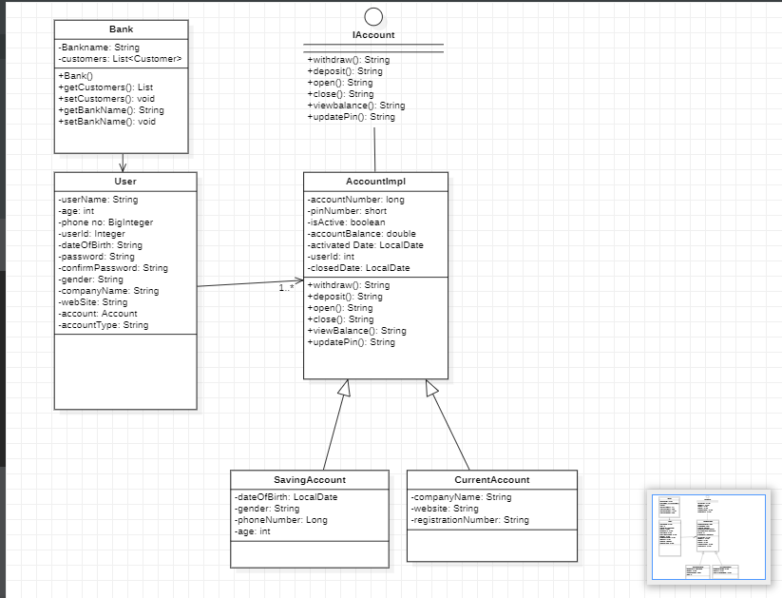
UML Diagram of Bank of Success Pvt. Ltd. Project

Slide 7
Concepts Used:
Interface
Has-a relationship
Inheritance
Annotations- @Entity, @Id, @Interface, @DiscriminatorColumn, @GeneratedValue, @JsonIgnore, @JoinColumn, @Component, @Service, @Autowired, @ResponseStatus, @ResponseBody, @PathVariable, @ControllerAdvice, @ExceptionHandler, @Transactional
Exceptions
List
Actuators
Swaggers

Slide 8
Concepts that will be implemented in next version
Hateoas
Aop
Security
Unit Testing

Slide 9
Validations:
Open an Account
a. Savings:
Validate if Age is greater than 18.
Set the IsActive status to true.
b. Current
Check if Registration Number is not null.
Set the isActive status to true.
If not valid then throw an exception indicating the exact issue and why account
could not be opened. AccountImpl Factory should be implemented as given in the design

Slide 10
sign up for the user
Requirements
Name
User_ID
Phone Number
Date Of Birth
Activated date

Slide 11
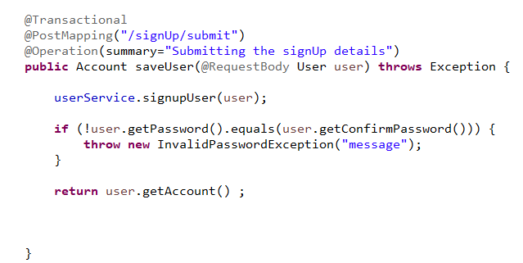

Slide 12
LOGIN for the user
Username: userId
Password: pin number
If both username and password matches login Successfully.
Otherwise throws an Exception based upon the wrong inputs.

Slide 13
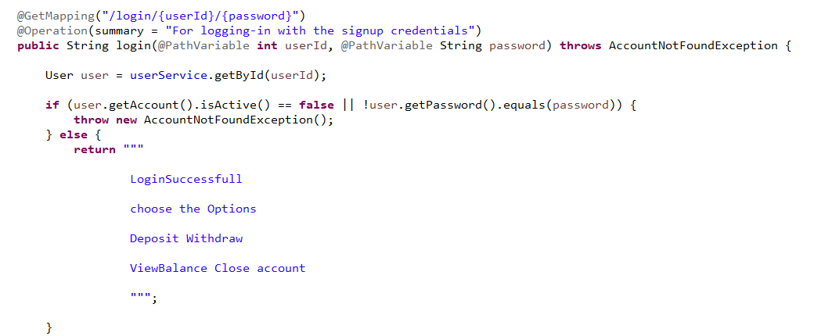

Slide 14
Deposit an Amount
a. Check If Account is Active
b. Add the amount to be deposited to Balance.
c. Send the status.
d. If any issue, then raise a specific exception to understand the exact failure of rule.

Slide 15
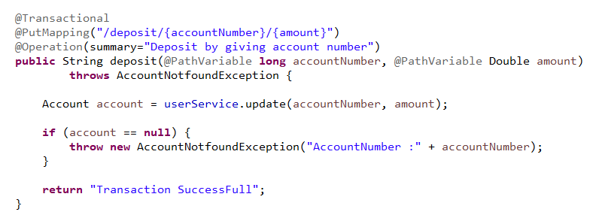

Slide 16
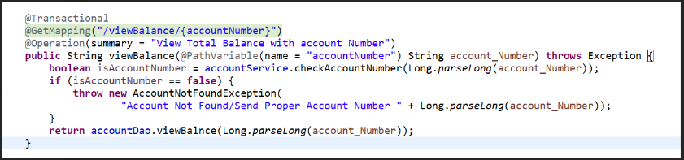
View Balance
a. Check If Account is Active
b. Check if accountNumber is valid.
c. Check the balance update the status.

Slide 17
Withdraw an Amount
Check If Account is Active
Check If Sufficient Balance is available
Deduct the amount to be withdrawn from Balance.
Send the status.
If any issue, then raise a specific exception to understand the exact failure of rule.

Slide 18
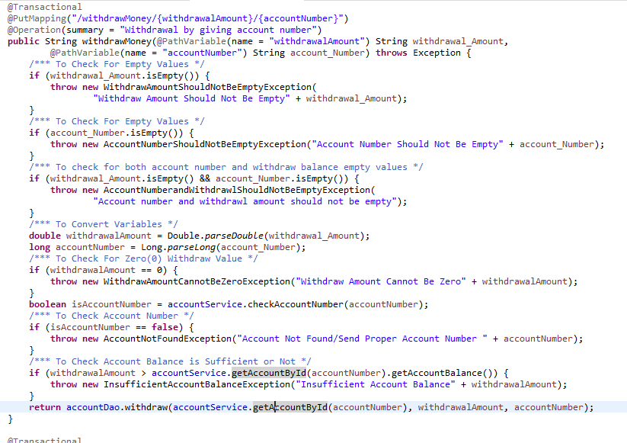

Slide 19
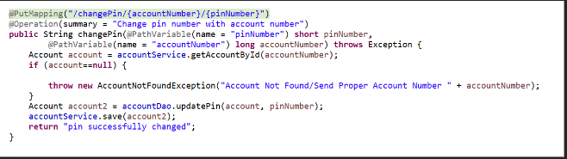
Set Pin
a. Check If Account is Active
b. Check if accountNumber is valid.
c. Check the pin update the status.

Slide 20
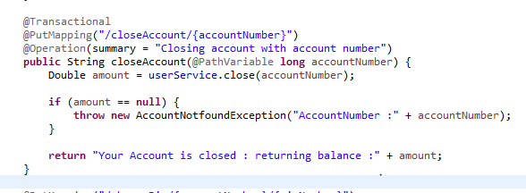
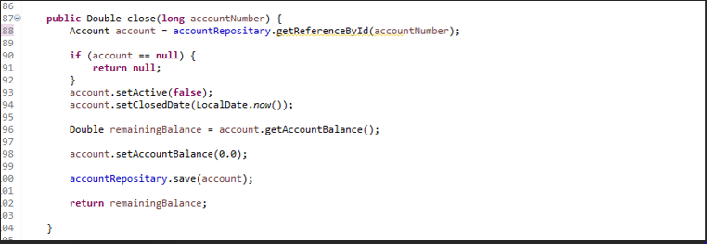
Close an Account
a. Set the status isActive to false

Slide 21
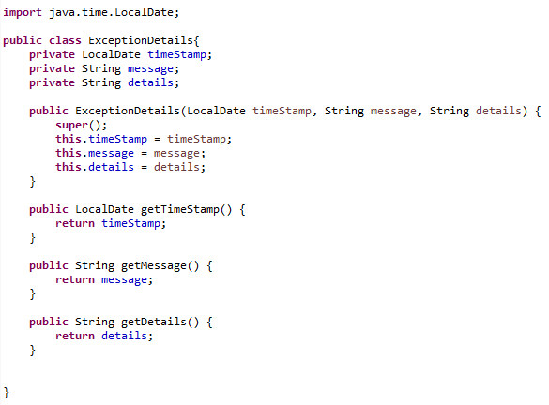
Exceptions

Slide 22
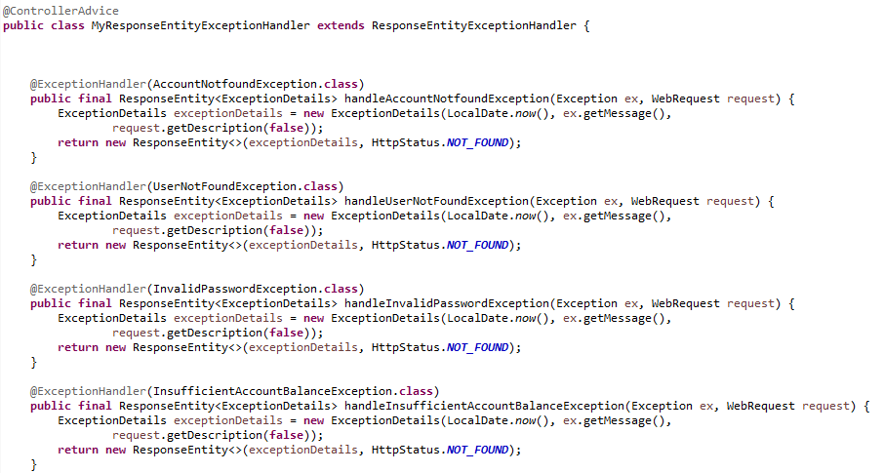

Slide 23
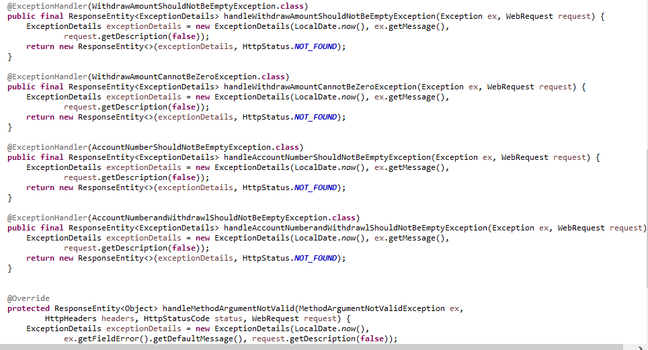

Slide 24
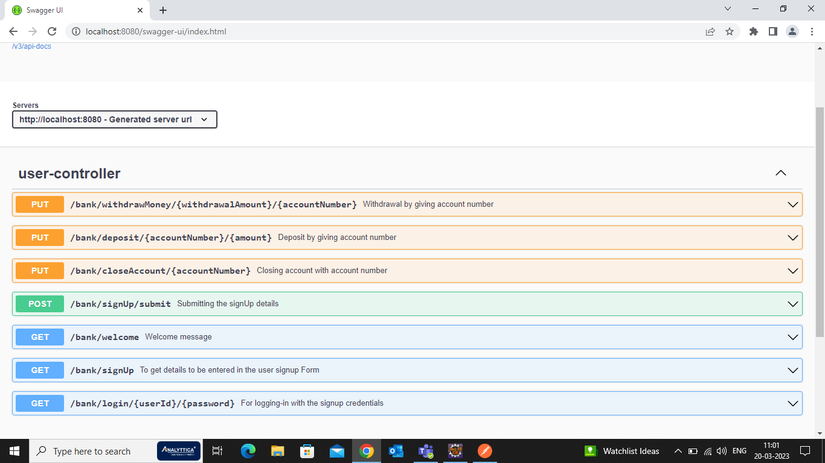
SWAGGRES

Slide 25
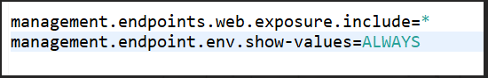
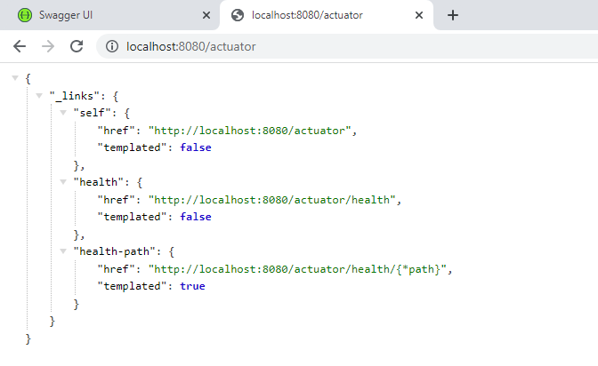
Actuators

Slide 26
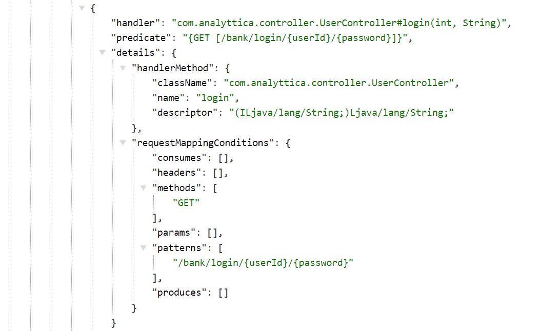

Slide 27
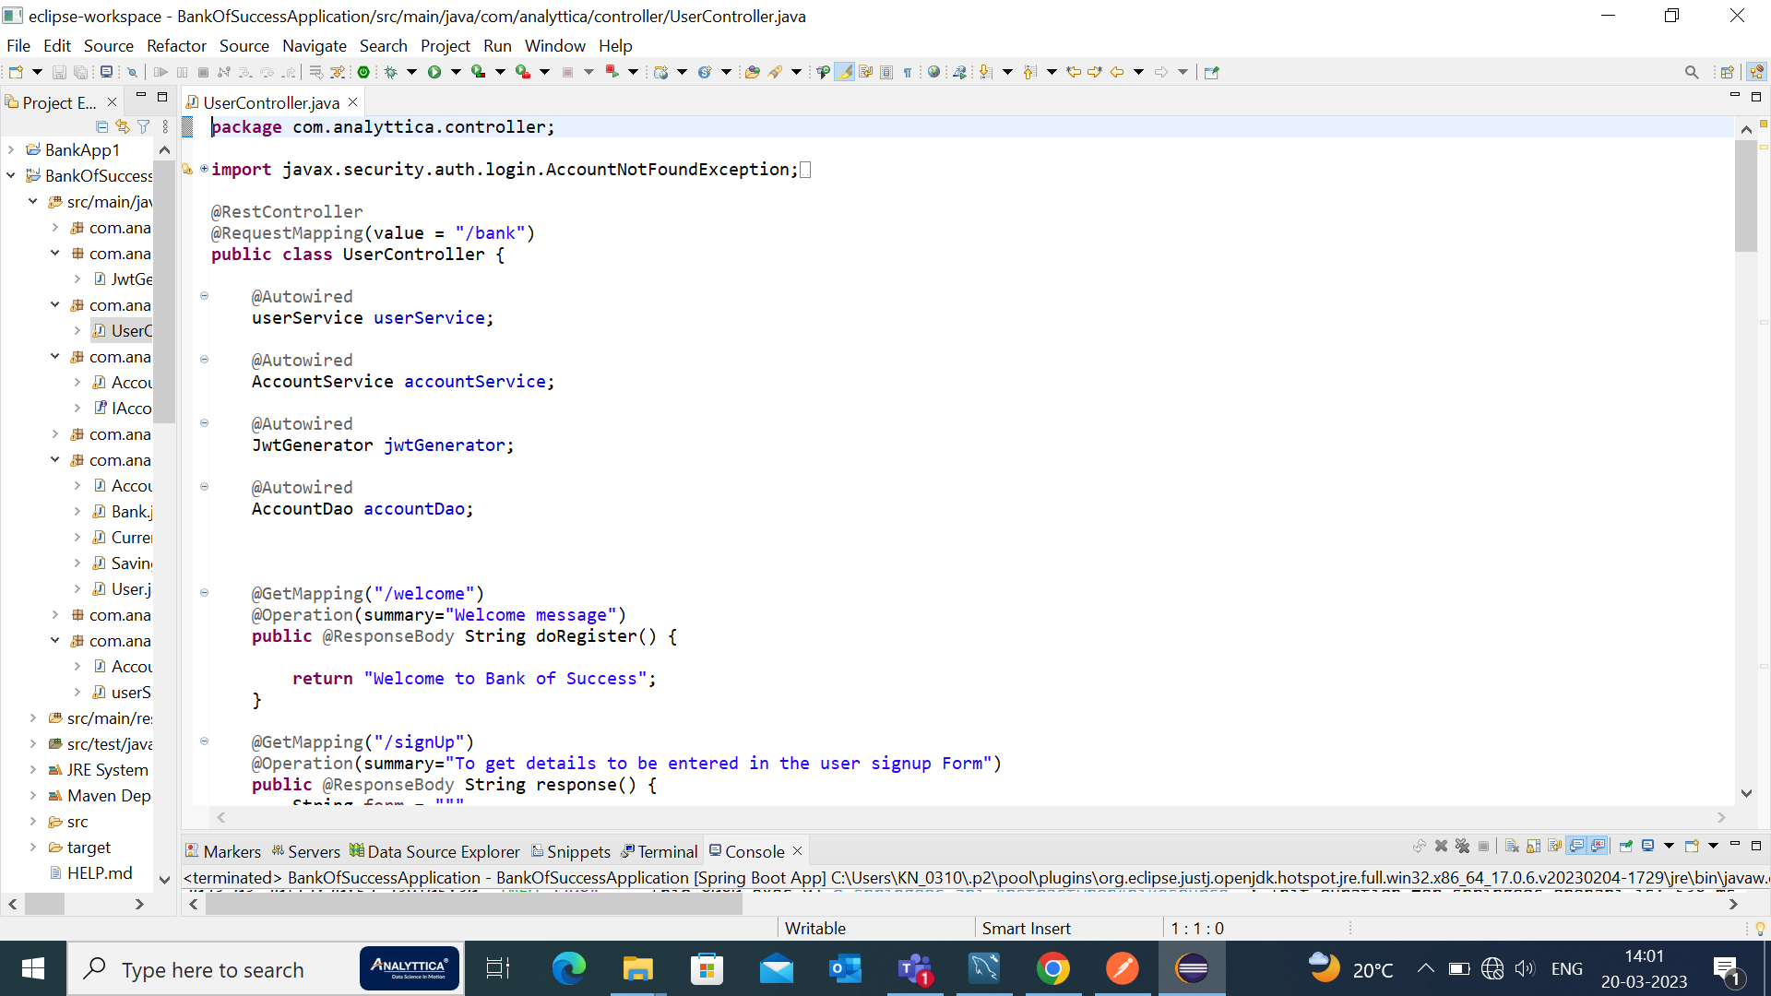
Code Snippets

Slide 28
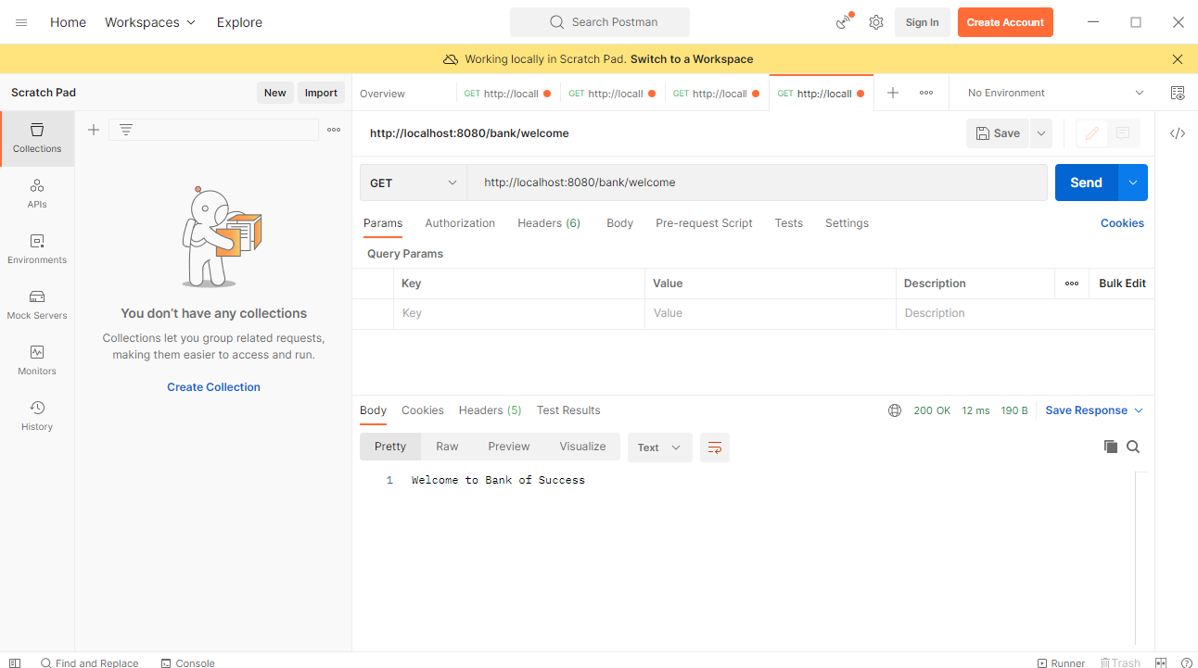
Welcome Page

Slide 29
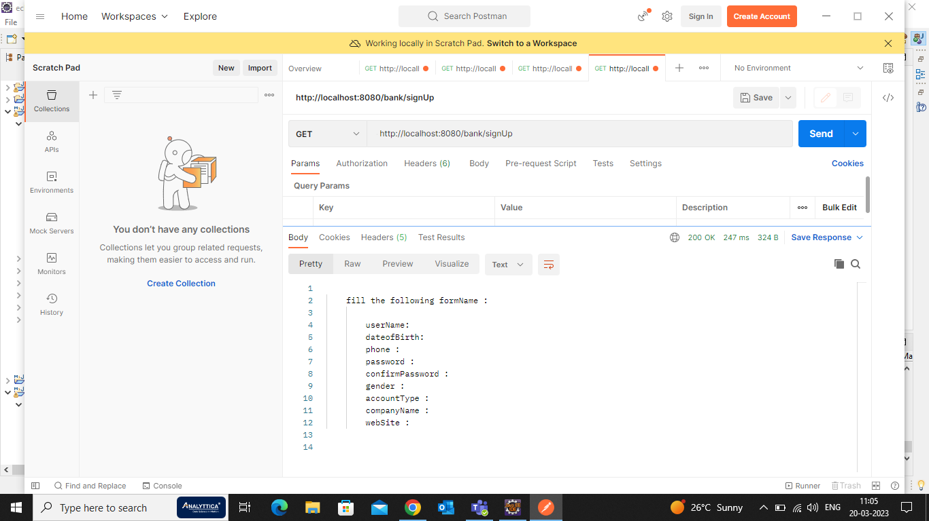
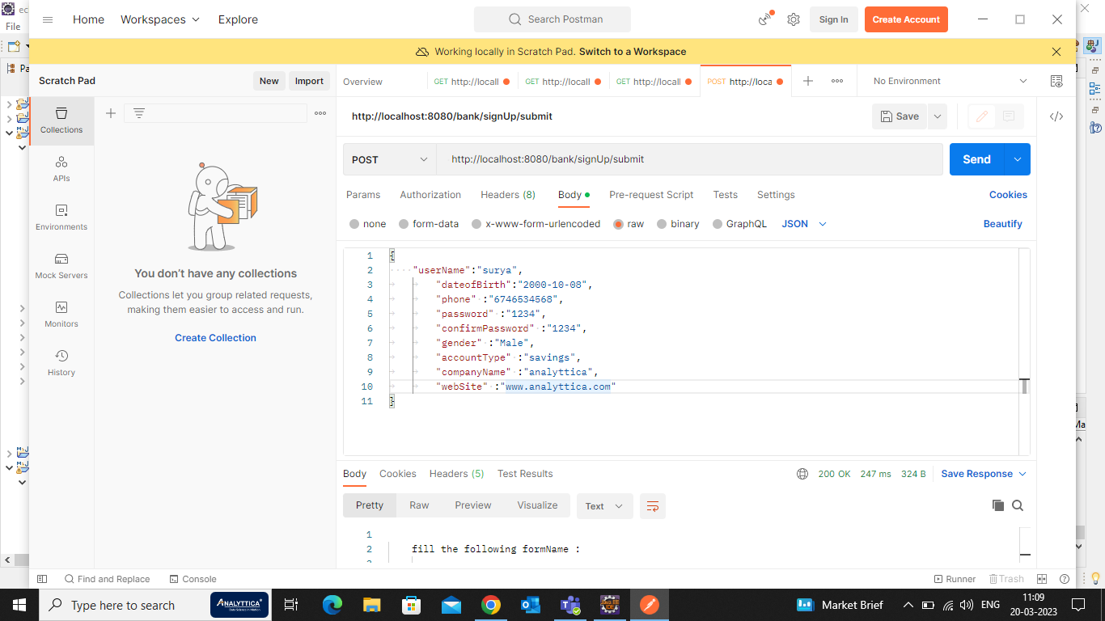
Sign Up :
If user have not created an account, then use create account API to create an account by providing all the necessary details.

Slide 30
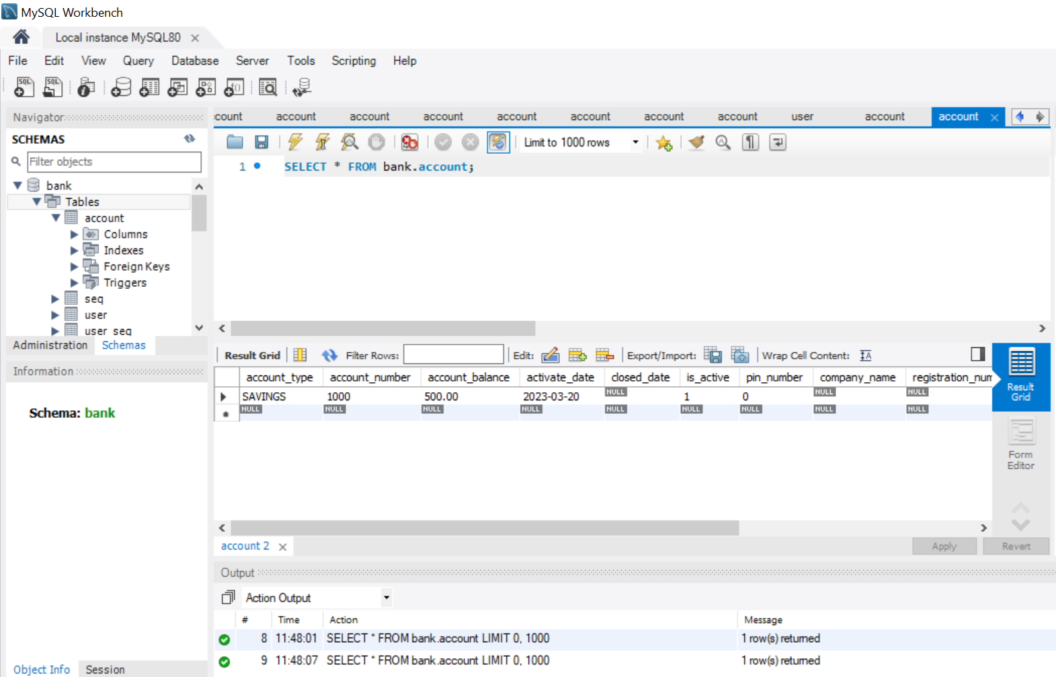

Slide 31
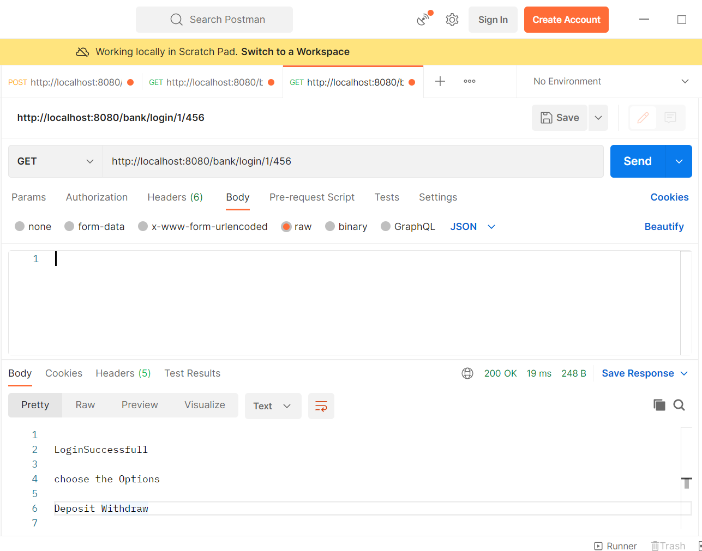

Slide 32
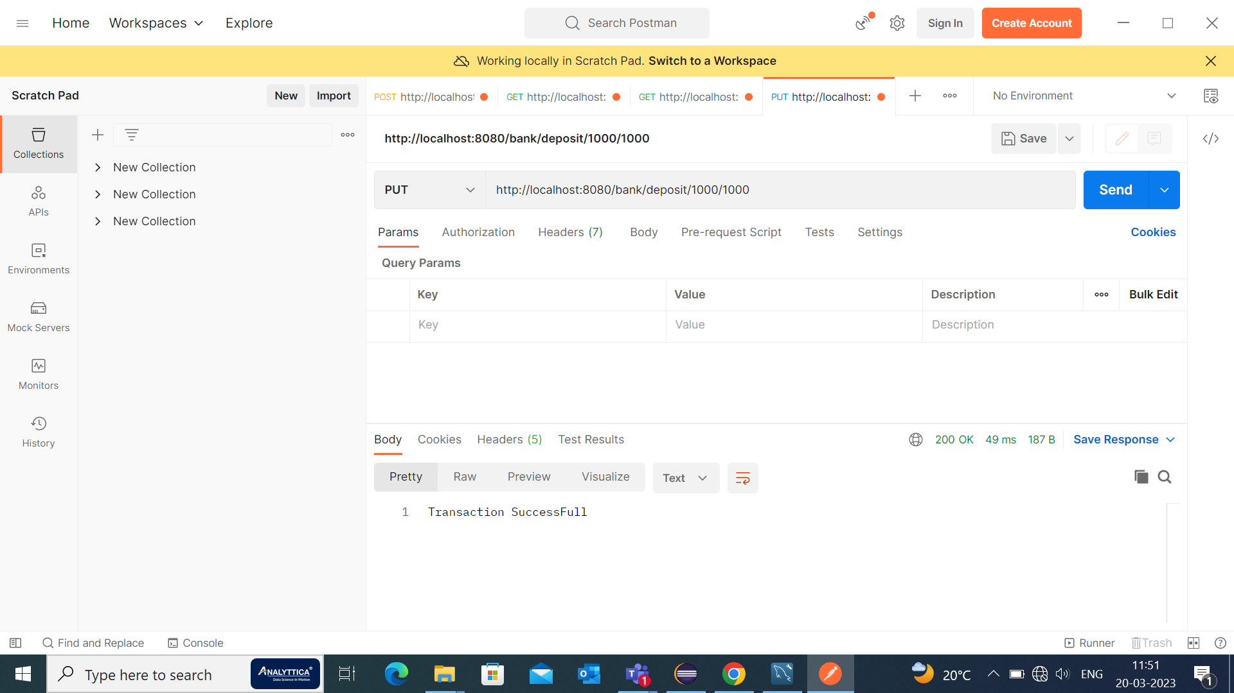

Deposit Cash:
Use noted accountNumber and provide amount greater than 0 to deposit case into an account.

Slide 33

Withdraw Money:
Use accountBalance and amount greater than zero to withdraw cash from an account.

Slide 34
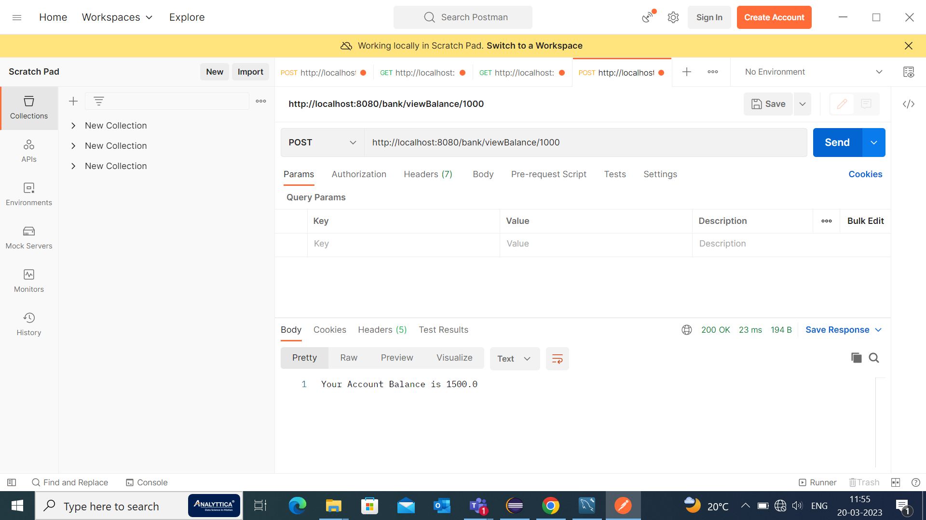

View Balance:
Use accountBalance to check bank balance.

Slide 35
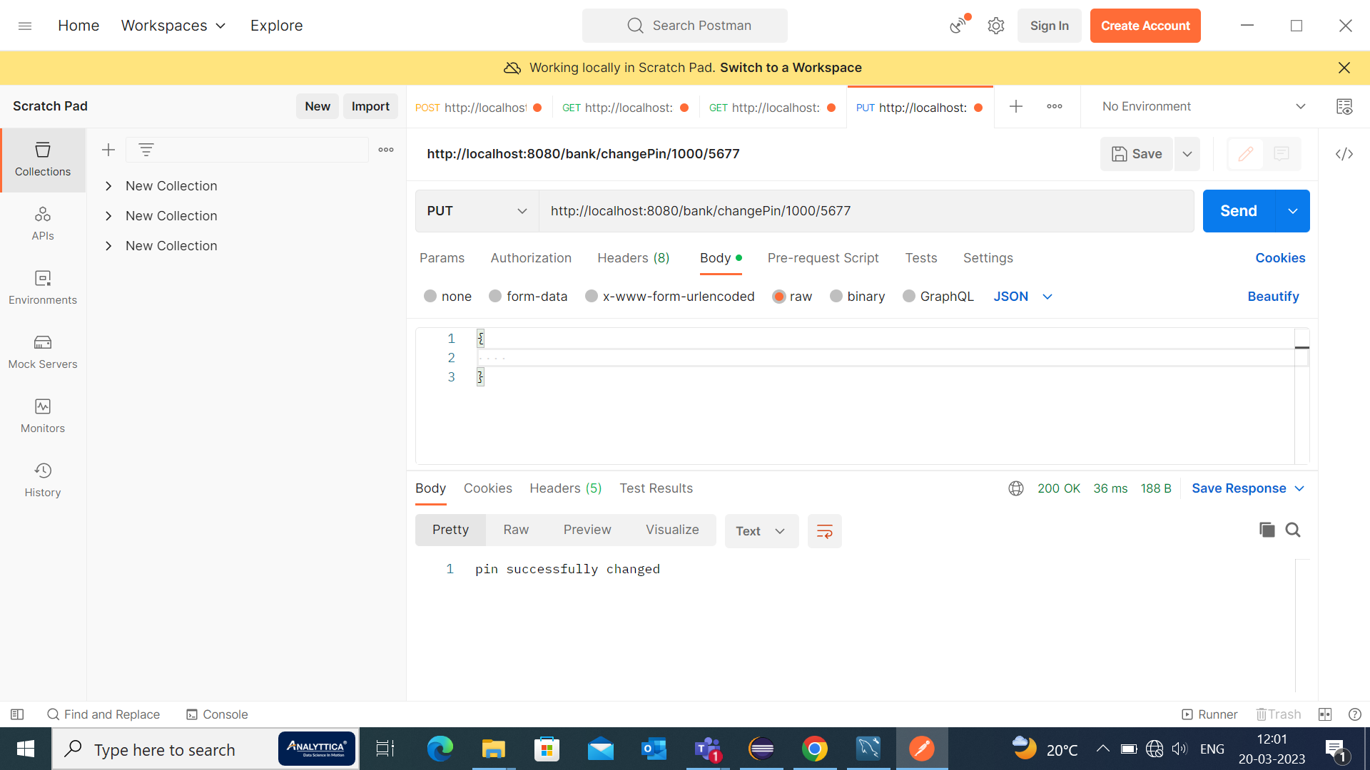
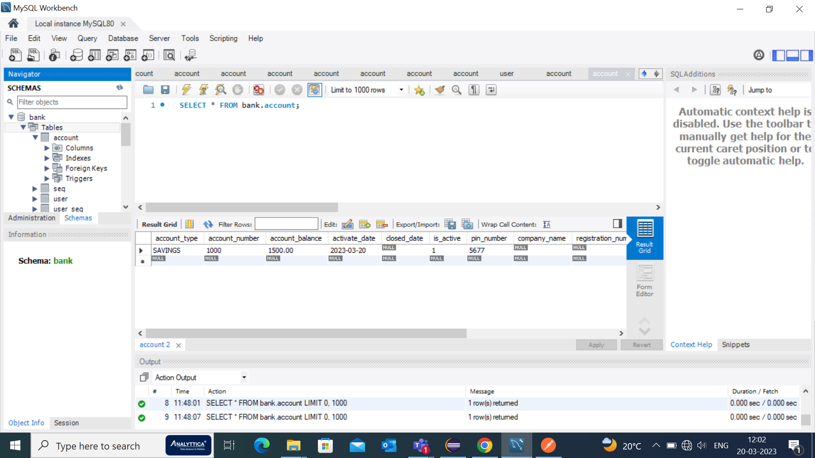
Diagram shows for changing a pin.

Slide 36


Close an account:

Slide 37
THANK YOU!

